Slide 1
Group 7 – Design Masterclass
Ross Warren and Zachari Cooper

Slide 2
The Brief
2D Mobile game
Simple tap on a mobile device
Multiplayer
Single Mobile Device
Symmetric
Engaging, Focused, Polished
Casual Users

Slide 3

Launch your stink balls at your deserving friends to make them reek for a week! in the bouncing shooter stink ball!

Slide 4
The Game Idea
Shooting
Twitch
First to 5 points wins
Fast paced
Creating:
Fiero
People Fun
Hard Fun

Slide 5

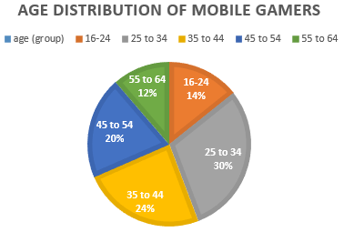
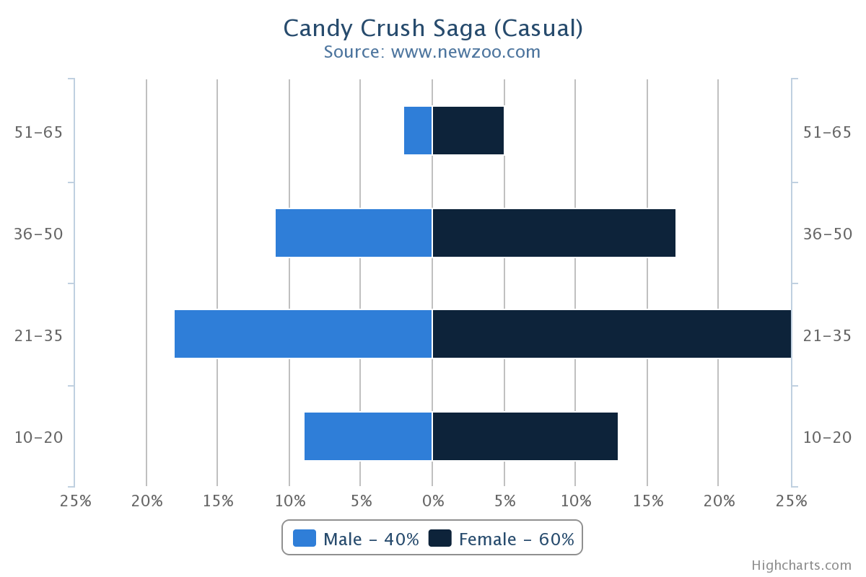
Demographic
Wide audience
Mid Core
Both genders
Ages between 16-34

Slide 6
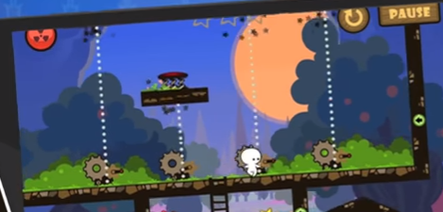
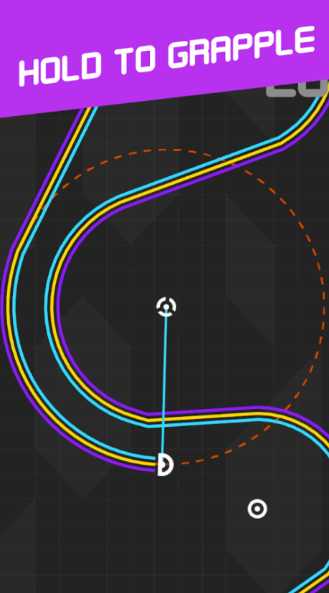
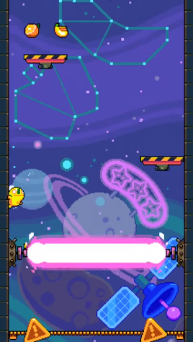
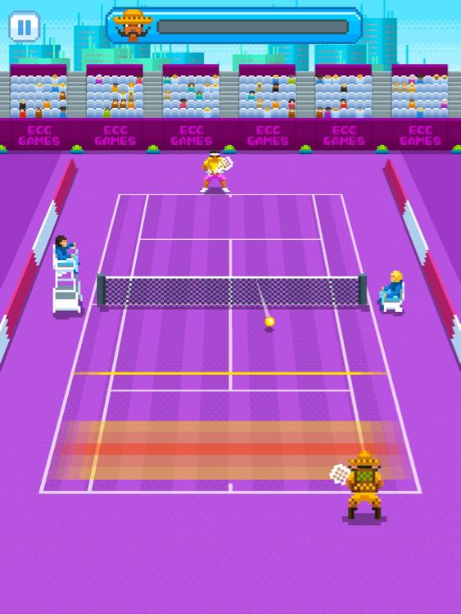
Research
Visual and audio feedback
Colour Scheme
Complimentary Colours
Warm Colours
Notes:
Research into games that require reactions and twitch

Slide 7
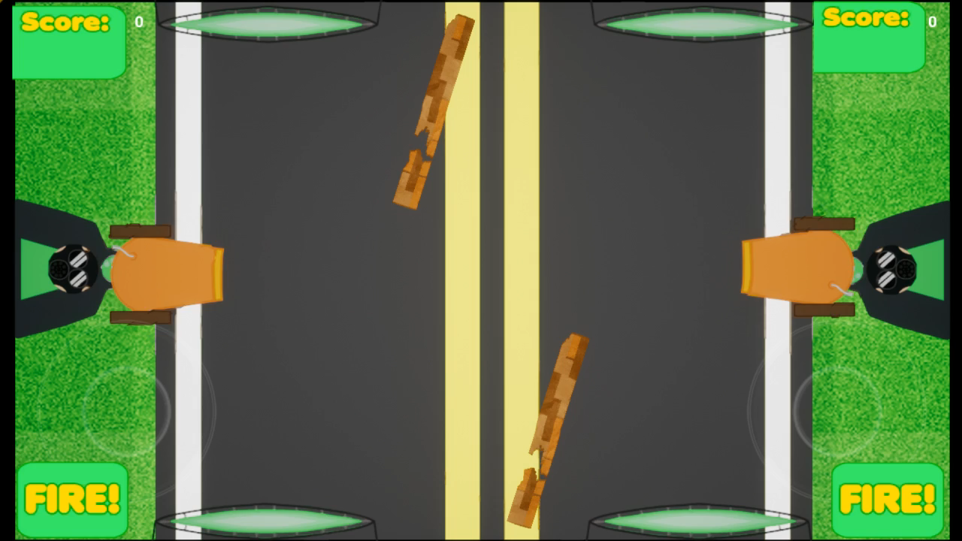
Gameplay
Notes:
Talk about bugs

Slide 8
Mechanics And Core game loop
Shooting
Twitch
Fire whenever ball goes off screen
One goal (the opponent)
Obstacles rotate in the center
Obstacles change every 10 seconds
Can be used to direct shots to target with skill

Slide 9


Feedback and Iterations
Alienation of world population
The skinning of our game went against the brief of meeting a large audience
Unclear on constraints of game
Needed to refine mechanics
Visual Re-Design and grounding of mechanics have been made

Slide 10

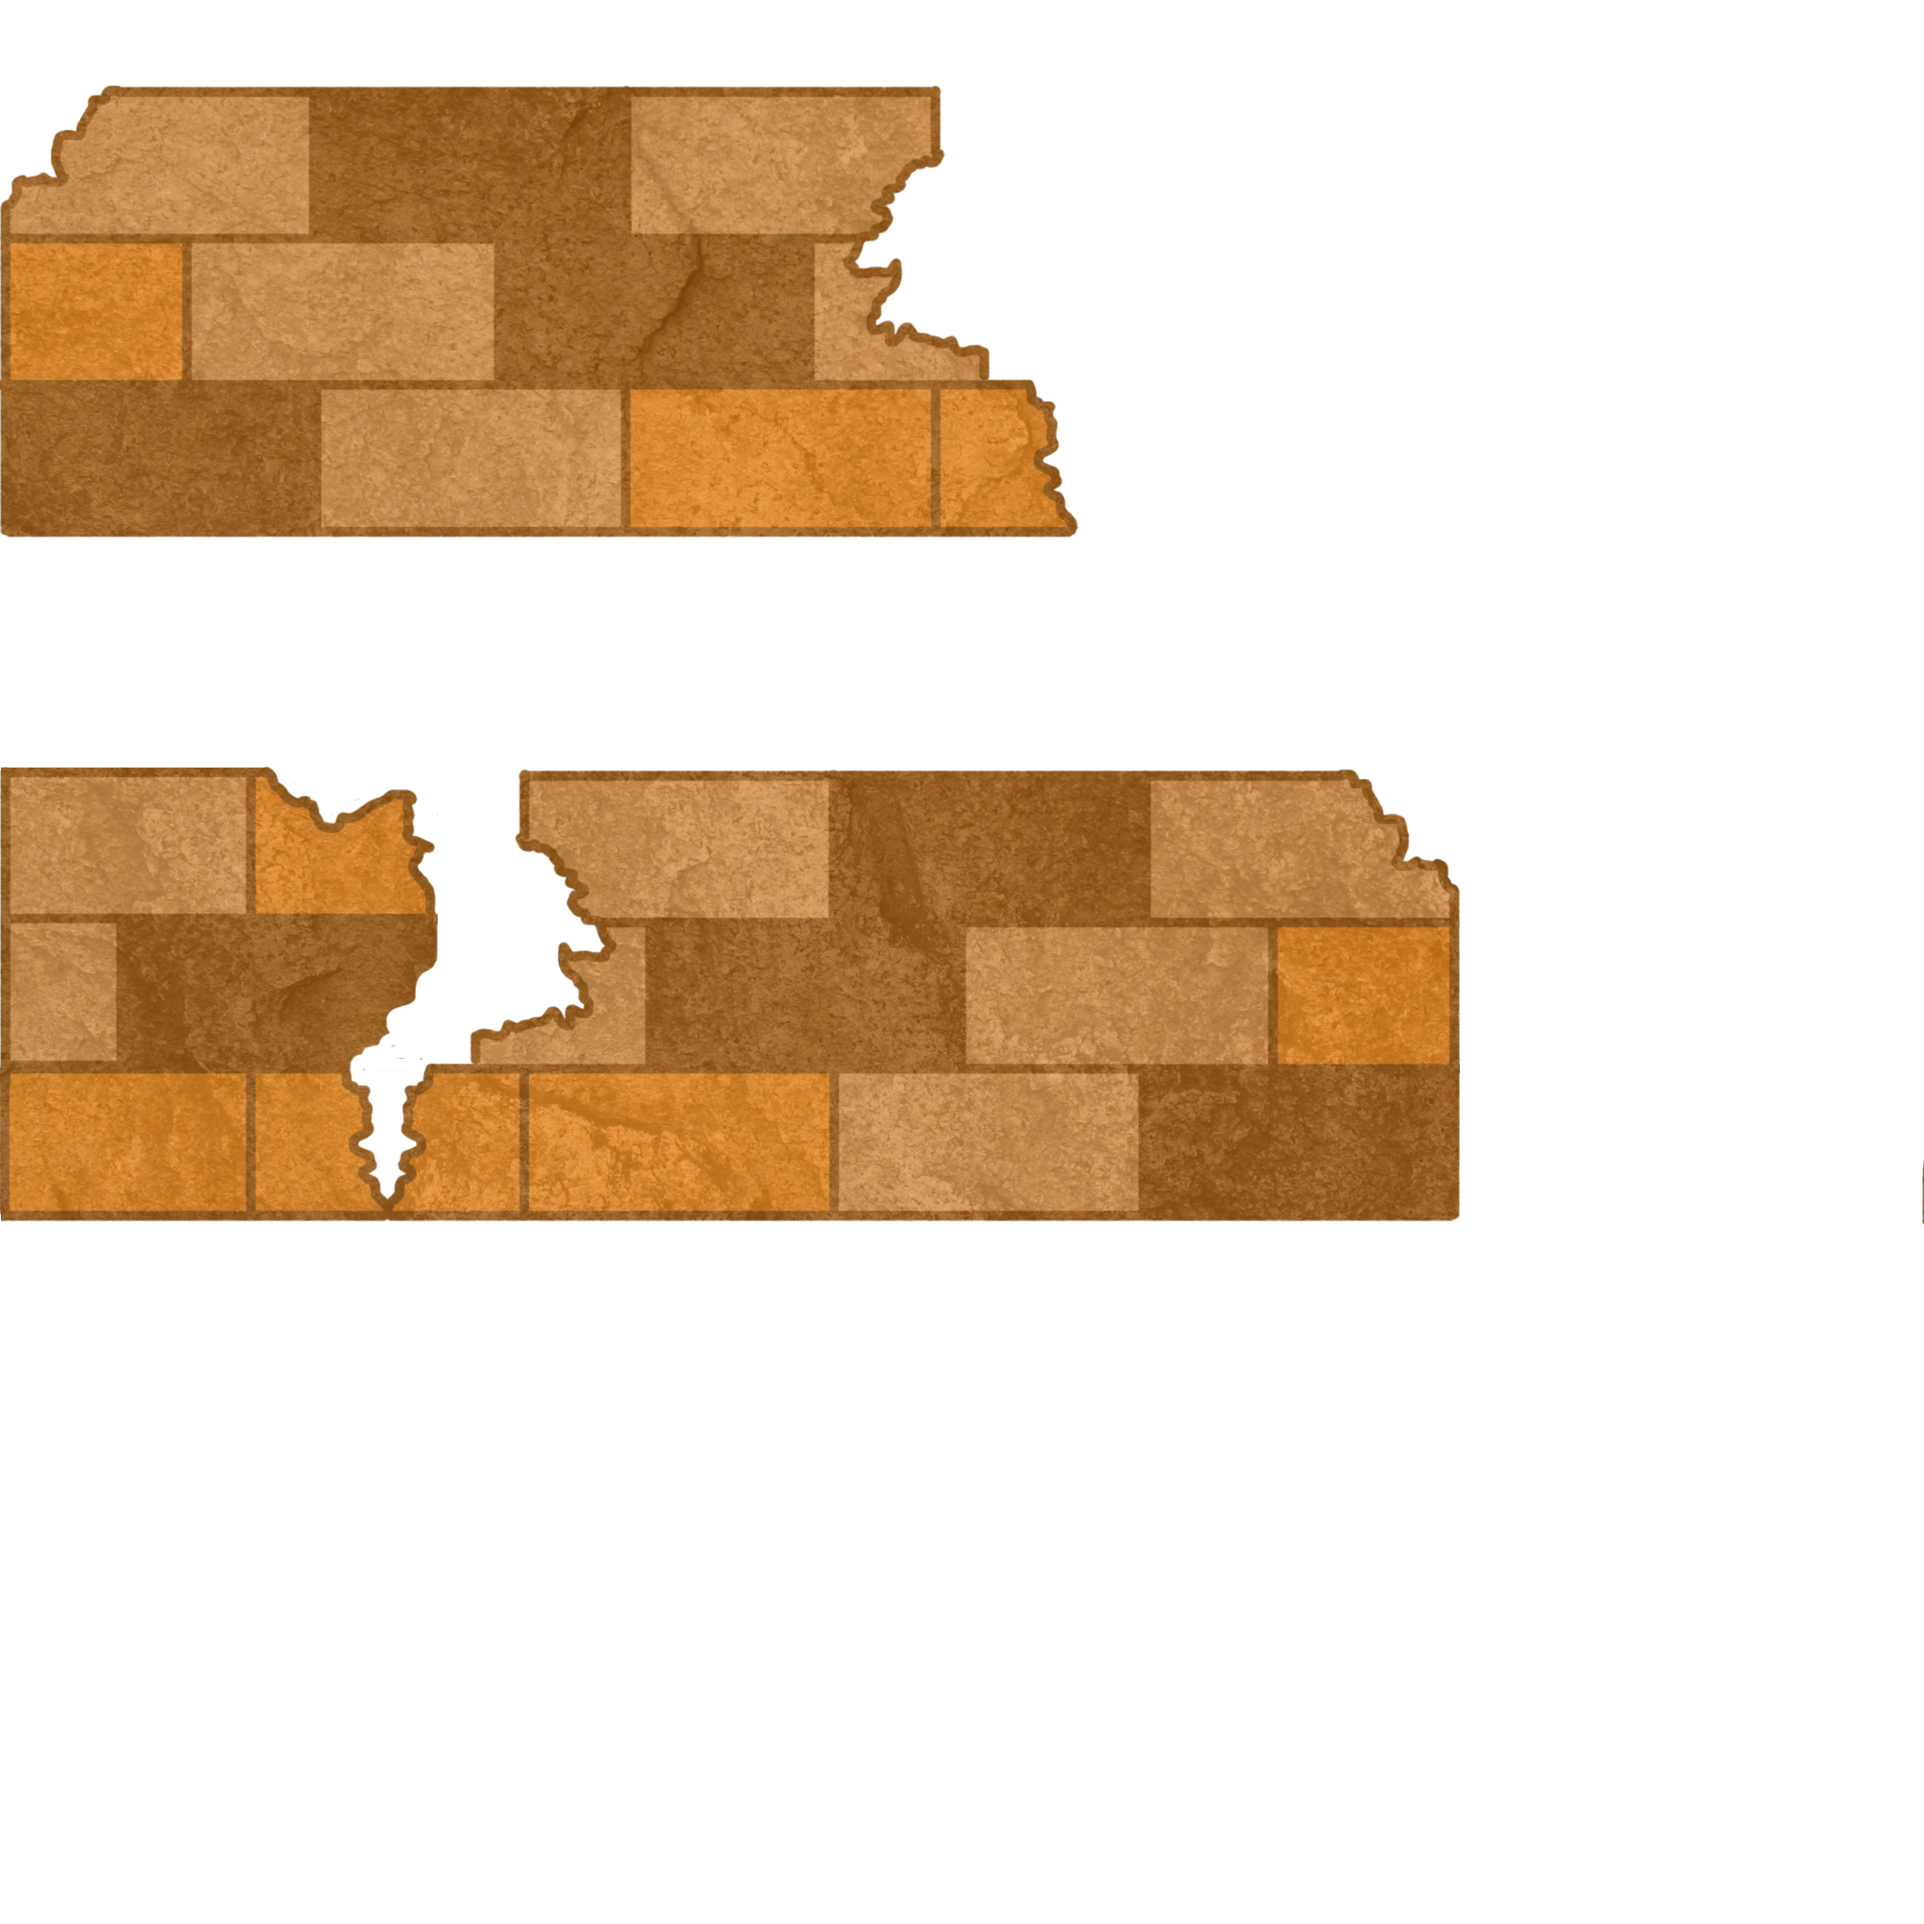
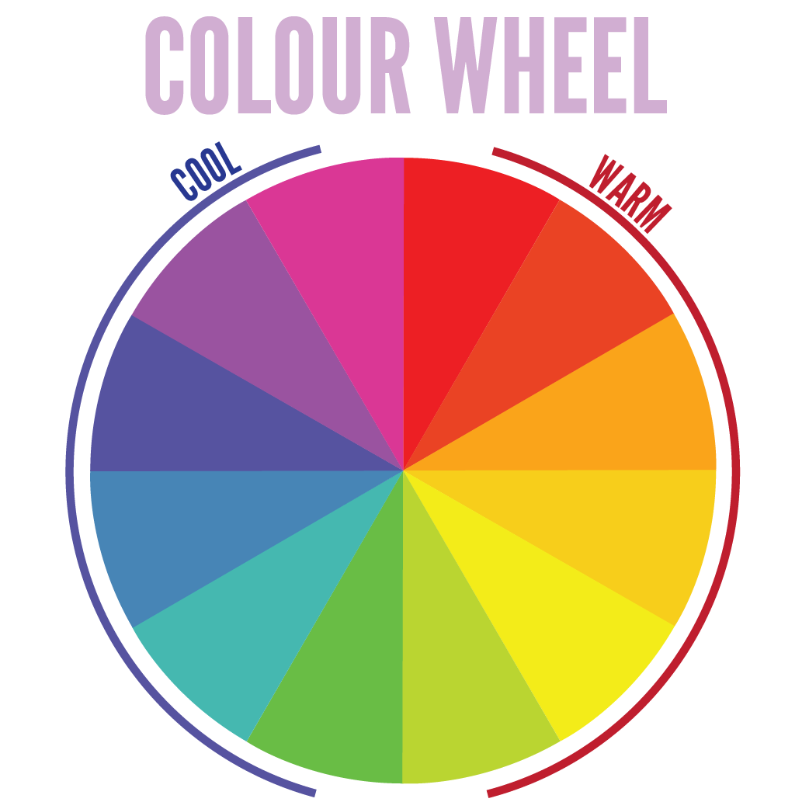

Art Design
Notes:
As the bridge between stimulating, warm colours (red, orange, yellow) and calming, cool colours (blue, purple), it is the most balanced of colours, lending it an air of stability.

Slide 11
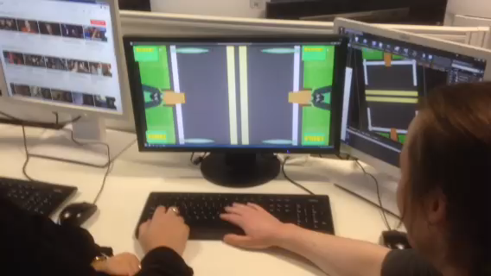
Playtesting

Slide 12
Management
Ross: 46 hours & 10 Minutes
Zach: 51 hours & 30 Minutes

Slide 13
Questions?
Ross Warren And Zachari Cooper

